Slide 1

DEPARTMENT OF COMPUTER SCIENCE & ENGINEERING
SCHOOL OF COMPUTING
1156CS601- MINOR PROJECT
WINTER SEMESTER 20-21
SEMESTER END PROJECT VIVA VOCE EXAMINATIONS
“Multilayer-Perceptron-Neural-Network-Supervised-Learning-based-Solar-Radiation-Prediction”
SUPERVISED BY
Dr. M.SHYAMLA DEVI M.E.,Ph.D.,
PROFESSOR
PRESENTED BY
1. K.V.THANOOJ (13186)(18UECS0438)
2. P.V.SANDEEP (13196)(18UECS0616)
3. A.JAYANTH (12550)(18UECS0072)

Slide 2
AGENDA
ABSTRACT
OBJECTIVE
INTRODUCTION
LITERATURE REVIEW (SOFT COPY OF PAPERS TO BE LINKED AS HYPERLINK)
DESIGN AND METHODOLOGIES
STANDARDS & POLICIES USED
IMPLEMENTATION
INPUT AND OUTPUT
INCLUDE DEMO VIDEO (You Tube URL )
CONCLUSION
FUTURE ENHANCEMENTS
WEB REFERENCES LINK
REFERENCES
PLAGIARISM REPORT OF PPT
POSTER PRESENTATION

Slide 3
ABSTRACT
Worldwide solar radiation is a basic parameter for the plan and operation frameworks. Long-standing records of worldwide solar radiation data are not accessible in many places because of the cost and maintenance of the measuring instruments. Sun based radiation expectation contains a incredible significance in power generation from sun based energy and makes a difference to measure photovoltaic control frameworks. With this context, we have utilized solar radiation dataset extracted from UCI Machine Learning. The forecasting of solar radiation are attained in four ways. Firstly, the data set is analyzed and preprocessed with Feature Scaling and missing values. Secondly, the correlation of the features is done and the relation of each features are visualized. Thirdly, the raw solar radiation data set is fitted to all the regressors and the implementation is furnished before and after scaling. Fourth, the raw data set is subjected to multilayer perceptron with various activation layers like identity, logistic, tanh and relu layers. The performance is analyzed with EVS, MAE, MSE, RScore and run time of the neural network layer. The execution is done using python language under Spyder platform with Anaconda Navigator. Experimental results shows that the Gradient boost regressor have the RScore of 0.98 before and after feature scaling. The MLP regressor with TANH activation layer is tends to retain 0.89 Rscore before and after feature scaling., and furthermore checks the credibility of the site distributing the news.

Slide 4
OBJECTIVES
Aim of the Project:
The aim is to create a model for the prediction of solar radiation that uses past weather data including temperatures, wind speed, air and moisture, and forecasts potential solar irradiance.
This model can help the grid operators for improved supply and demand management.
Scope of the Project:
The scope is that the proposed model can help energy providers for optimal planning of solar energy systems . The solution can help power distribution system in effectively predicting the source power and accordingly utilize alternate energy sources .

Slide 5
INTRODUCTION
Currently, energy consumption is one of the criteria used in the analysis of countries economic development, which is in sharp expansion due to economic progress and development and increased demand, especially in the renewable energy
One of the most important challenge for the near future global energy supply will be the Wide incorporation of renewable sources of energy in current or future energy supply structures (particularly non-predictable sources such as wind and solar).
Energy systems mostly use fossil fuels such as oil, gas, and coal. They are depleting at a rapid rate and their prices are highly unpredictable. However, to reduce CO2 emissions and meet the challenge of reducing climate change, these systems need to include a range of renewable energy resource (RES) fluctuations such as wind and solar energy.
Solar energy is one of the most abundantly available sources of renewable energy. For proper planning and designing of solar energy systems, adequate knowledge of solar radiation and other pertinent meteorological parameters is necessary.

Slide 6
LITERATURE REVIEW
(SOFT COPY OF PAPERS TO BE LINKED AS HYPERLINK)
LS1
LS2
LS3
LS4
LS5
LS6
LS7
LS8
LS9
LS10

Slide 7
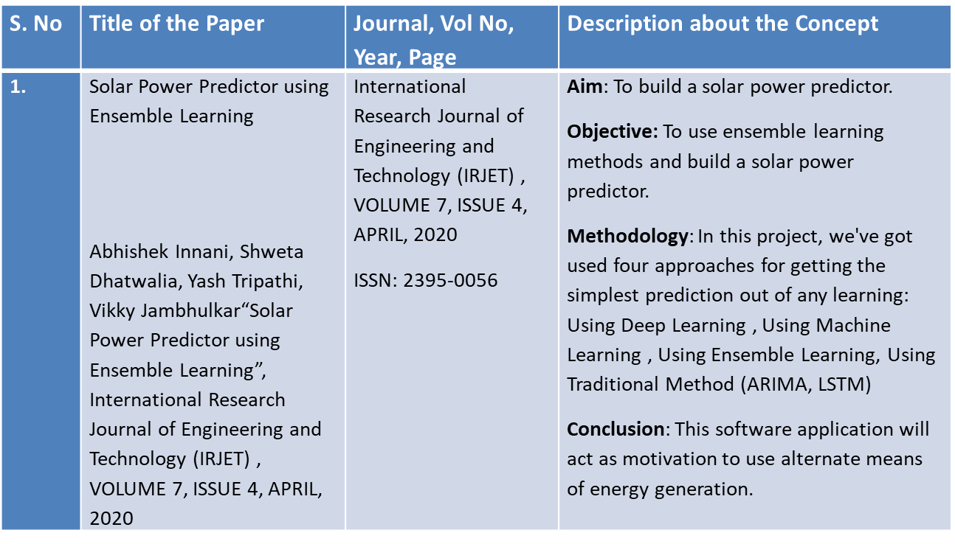
LITERATURE REVIEW
Author(s) name(s), year, “journal name”, publisher
Conclusion of the journal

Slide 8
LITERATURE REVIEW
S. No | Title of the Paper | Journal, Vol No , Year, Page | Description about the Concept
2. | Effective Estimation of Hourly Global Solar Radiation Using Machine Learning Algorithms Abdurrahman Burak Guher , 1 Sakir Tasdemir , 2 and Bulent Yaniktepe 3“Effective Estimation of Hourly Global Solar Radiation Using Machine Learning Algorithms” International Journal of Photoenergy, 2020 | INTERNATIONAL JOURNAL OF SCIENTIFIC & TECHNOLOGY RESEARCH(IJSTR), VOLUME 8, ISSUE 12, 2020 ISSN 2277-8616 | Aim: To build a model that estimate solar radiation. Objective: To use ML algorithms and build a model that estimates solar radiation. Methodology: The input data were determined in five different groups at the end of the selection process, and the development processes of the best ML models were explained for each group. Conclusion: In the present study, a comparative evaluation was made by developing models based on four different ML..

Slide 9
LITERATURE REVIEW
S. No | Title of the Paper | Journal , Vol No , Year, Page | Description about the Concept
3. | Clustering Model For Solar Irradiation Prediction Using Machine Learning Algorithm Prachi Sharma, Dr.Megha Kamble, “Clustering Model For Solar Irradiation Prediction Using Machine Learning Algorithm”, INTERNATIONAL JOURNAL OF SCIENTIFIC & TECHNOLOGY RESEARCH(IJSTR), VOLUME 8, ISSUE 12, DECEMBER 2019 | INTERNATIONAL JOURNAL OF SCIENTIFIC & TECHNOLOGY RESEARCH(IJSTR), VOLUME 8, ISSUE 12, DECEMBER 2019 ISSN 2277-8616 | Aim: To build a clustering model for solar prediction. Objective: To use ML algorithms and build a clustering model for solar prediction. Methodology :Ensemble approaches helps to combine various advantages of different ML approaches to develop one predictive model for decreasing the variance , bias as well as improving the predictions . Conclusion: The performance of the proposed approach will be estimated by means of the following measure, Mean Absolute Error (MAE) Normalized Root Mean Square Error (nRMSE) Prediction Accuracy (%).

Slide 10
DESIGN AND METHODOLOGIES
MODULE 1:
Data Collection and training using Machine Learning Algorithms
MODULE 2:
Solar Radiation dataset analysis.
MODULE 3:
Data Fitted Into Regressors

Slide 11
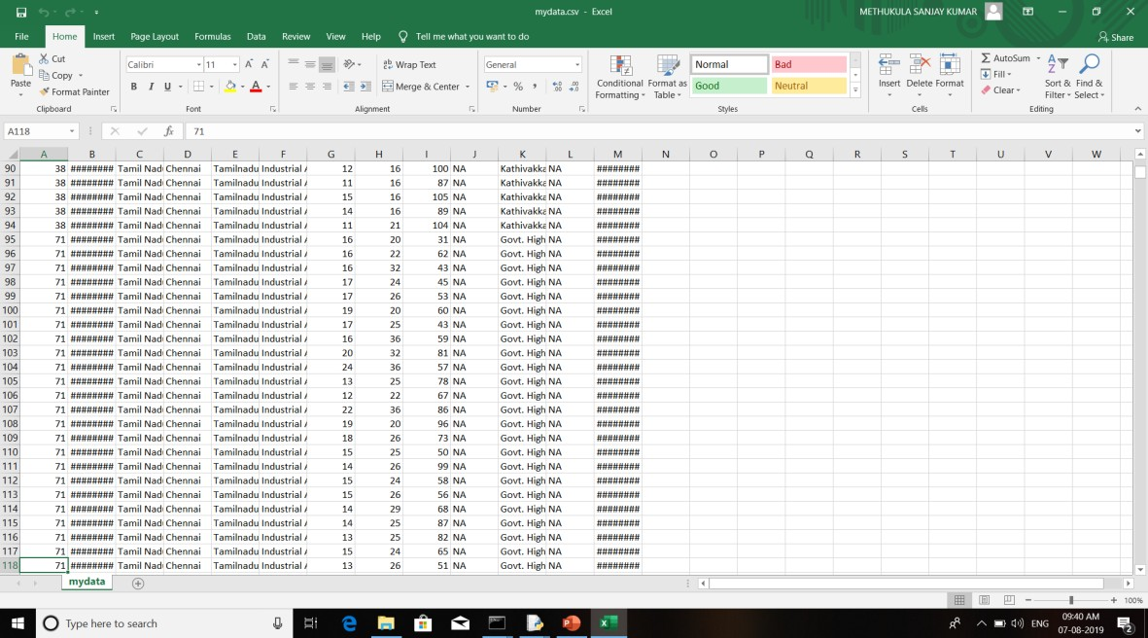
Data Collection and training using Machine Learning Algorithms
Collection of data

Slide 12
DATA COLLECTION
The data selection is the process of selecting the data for detecting the attacks.
In this project, the solar radiation dataset is used for predicting
It includes parameters like radiation, temperature, humidity, pressure, wind direction

Slide 13
DATA ANALYSIS
Data pre-processing is the process of removing the unwanted data from the dataset.
Missing data removal
Encoding Categorical data
Missing data removal: In this process, the null values such as missing values are removed using imputer library.
Encoding Categorical data: That categorical data is defined as variables with a finite set of label values. That most machine learning algorithms require numerical input and output variables. That an integer and one hot encoding is used to convert categorical data to integer data.

Slide 14
DATA FITTED INTO REGRESSORS
After the correlation of the features is done
The relation of each features are visualized. the raw solar radiation data set is fitted to all the regressors and the implementation is furnished before and after scaling.

Slide 15
STANDARDS & POLICIES USED
Standards :
The standards has to be followed for the managing the quality. The following IEEE standards included in the project:
IEEE 1016:standard for Software Design Description.
IEEE 1028:Standard for Software Reviews and Audits.
IEEE 1471:standard for software architecture / system architecture.
IEEE 12207:Information Technology – Software life-cycle processes.
IS 1885-52-15:Programming languages.

Slide 16
STANDARDS & POLICIES USED
Policies :
The IEEE and other policies that included in the project are:
Mandatory plagiarism detection policy.
IEEE Open Access policy.
Author posting policy.
Copyright infringement policy.
Scope of the project policy.

Slide 17
IMPLEMENTATION
ARCHITECTURE DIAGRAM
DATA FLOW DIAGRAM
ER DIAGRAM
SEQUENCE DIAGRAM
COLLABORATION DIAGRAM

Slide 18
ARCHITECTURE DIAGRAM
Data set
Preprocess the data
Regression
Algorithm
Performance analysis
Preprocessed data set
metrics mean squared error
Mean Absolute Error
Classification
Prediction
18
15
A Detailed Investigation and Analysis of using Machine Learning Techniques for Intrusion Detection
2/22/2019

Slide 19
DATA FLOW DIAGRAM
Select dataset
Preprocess dataset
Regression
Algorithm
Performance analysis
Split train and test data
Classification
Prediction
19

Slide 20
ER-DIAGRAM
Load dataset
Cleaning dataset
Start
Data selection and loading
Vectorize data
Regression analysis
Result generation
Classification
Split train and test set
20

Slide 21
SEQUENCE DIAGRAM
Start
Select
Analysis
Outcome
Select dataset
Load dataset
Result Generation
Classification
Prediction

Slide 22
COLLABORATION DIAGRAM
Dataset Split(Train | Test)
Pre processing and Feature Extraction
Dataset
User input
Classification model
Training the Classifier
Prediction
True / False

Slide 23
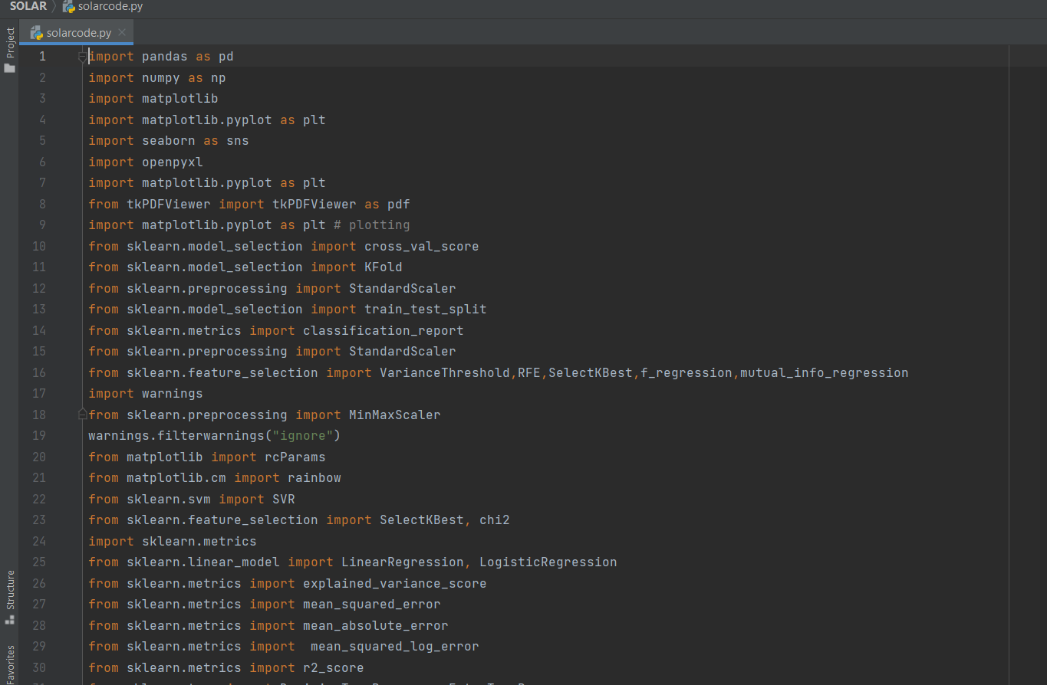
INPUT AND OUTPUT

Slide 24
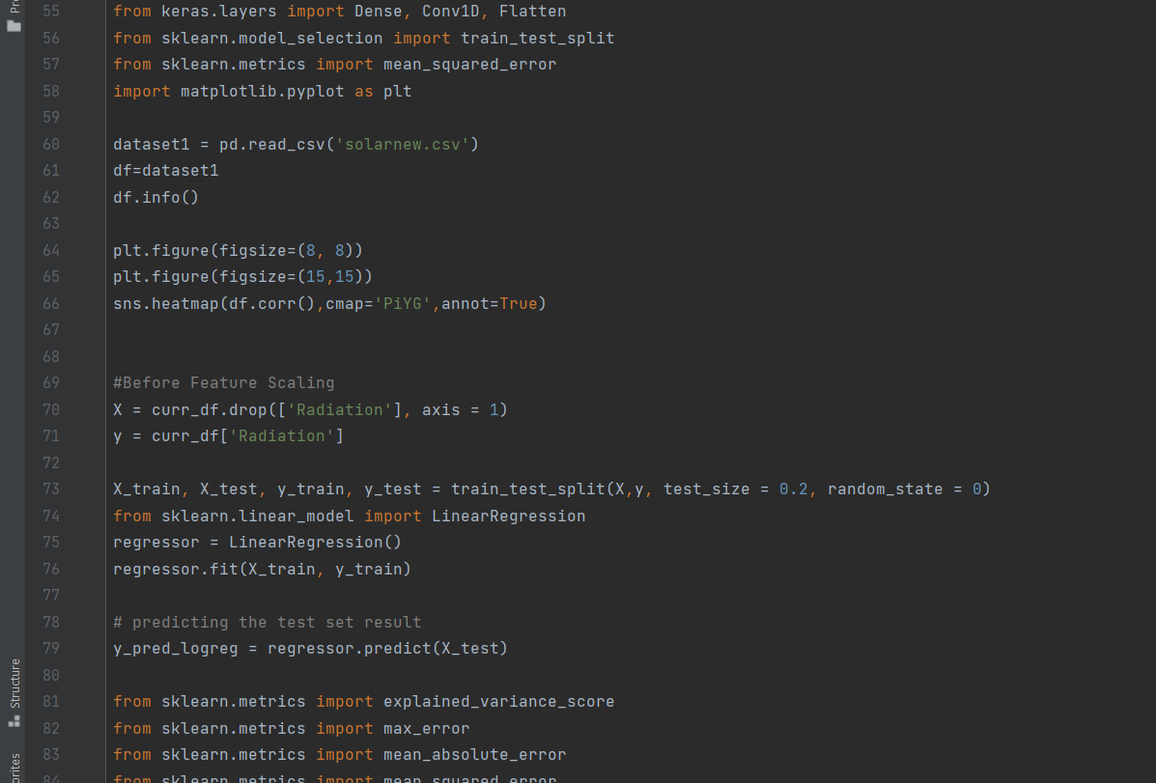
INPUT AND OUTPUT

Slide 25
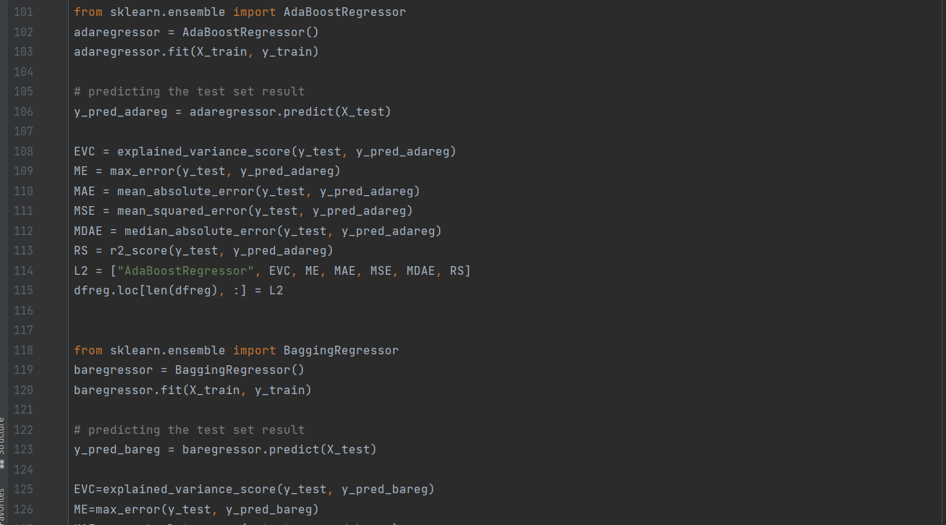
INPUT AND OUTPUT

Slide 26
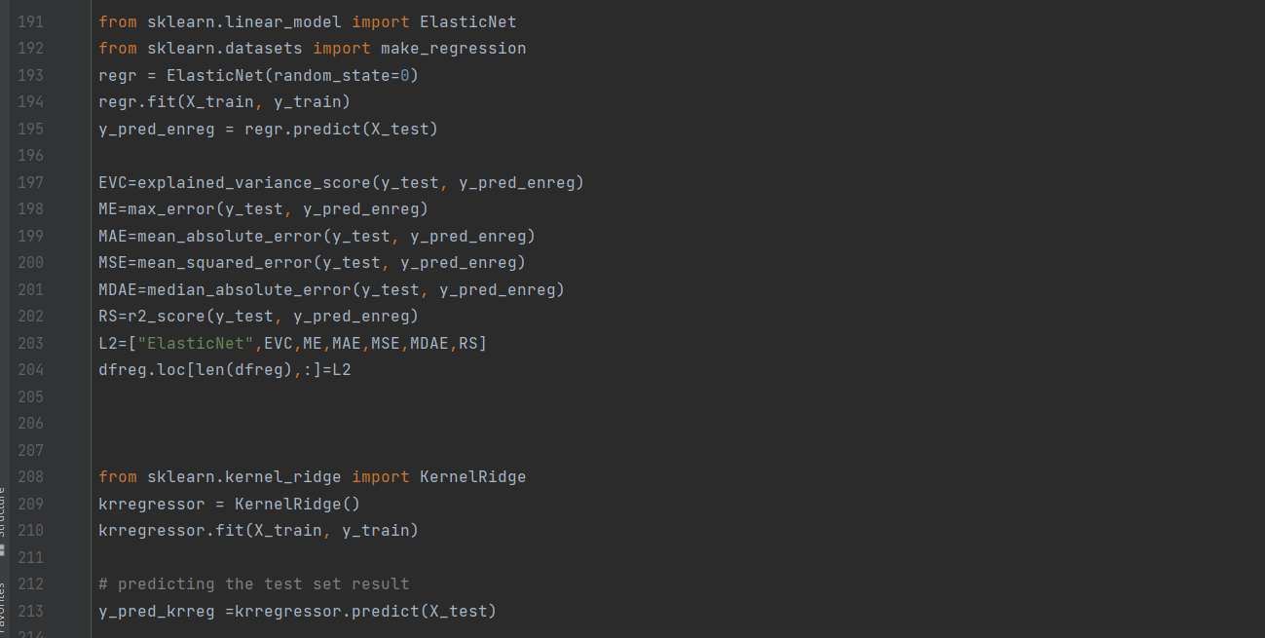
INPUT AND OUTPUT

Slide 27
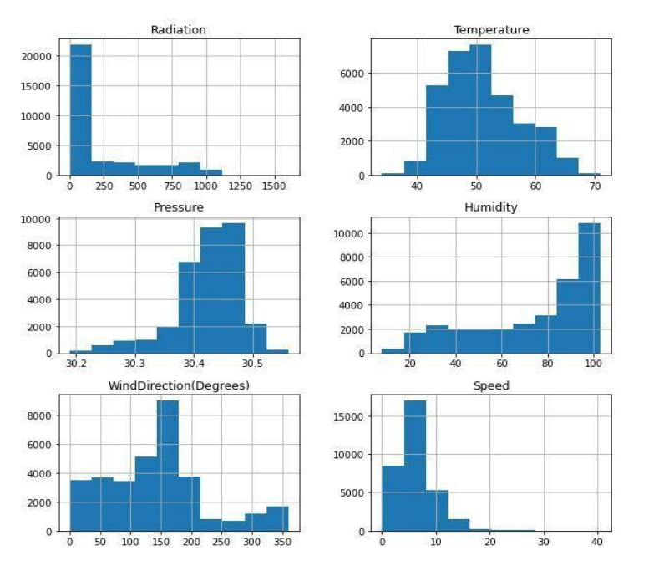
INPUT AND OUTPUT
Graph of radiation, temperature, humidity, pressure, wind direction

Slide 28
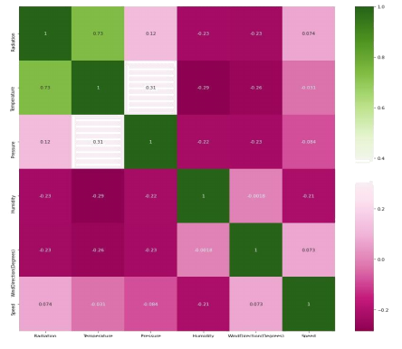
INPUT AND OUTPUT
Relationship between radiation, temperature, Humidity, Pressure, Wind Direction

Slide 29
INPUT AND OUTPUT
Regressor | EVS | MSE | MAE | RScore | Running Time (ms)
Linear | 0.57 | 0.000439537 | 1.5778 | 0.57 | 0.14
Ridge | 0.57 | 0.000439535 | 1.5779 | 0.57 | 0.01
ElasticNet | 0.55 | 0.000453448 | 1.6249 | 0.55 | 0.01
Lars | 0.57 | 0.000439537 | 1.5778 | 0.57 | 0.01
LarsCV | 0.57 | 0.000439537 | 1.5778 | 0.57 | 0.07
Lasso | 0.56 | 0.00044339 | 1.5937 | 0.56 | 0.01
LAssoLarsCV | 0.57 | 0.000439537 | 1.5778 | 0.57 | 0.05
Bayesian | 0.57 | 0.000439536 | 1.5778 | 0.57 | 0.02
ARD | 0.57 | 0.000439555 | 1.5780 | 0.57 | 0.03
DecisionTree | 0.52 | 0.000488893 | 1.0998 | 0.52 | 0.16
ExtraTree | 0.49 | 0.000512972 | 1.1300 | 0.79 | 0.05
AdaBoost | 0.59 | 0.000451648 | 1.6225 | 0.55 | 0.49
Gradient Boost | 0.69 | 0.000316029 | 1.0973 | 0.96 | 1.84
RandomForest | 0.58 | 0.000427887 | 1.3801 | 0.88 | 0.93
Regressor performance of the raw dataset before scaling

Slide 30
INPUT AND OUTPUT
Regressor | EVS | MSE | MAE | RScore | Running Time (ms)
Linear | 0.57 | 0.000439537 | 1.5778 | 0.57 | 0.01
Ridge | 0.57 | 0.000439537 | 1.5777 | 0.57 | 0.01
ElasticNet | 0.50 | 0.000508116 | 1.7213 | 0.50 | 0.00
Lars | 0.57 | 0.000439537 | 1.5778 | 0.57 | 0.00
LarsCV | 0.57 | 0.000439537 | 1.5778 | 0.57 | 0.04
Lasso | 0.57 | 0.000439636 | 1.5786 | 0.57 | 0.00
LAssoLarsCV | 0.57 | 0.000439537 | 1.5778 | 0.57 | 0.05
Bayesian | 0.57 | 0.000439537 | 1.5777 | 0.57 | 0.01
ARD | 0.57 | 0.000439555 | 1.5780 | 0.57 | 0.01
DecisionTree | 0.51 | 0.000492491 | 1.1065 | 0.51 | 0.16
ExtraTree | 0.49 | 0.000512972 | 1.1300 | 0.76 | 0.05
AdaBoost | 0.58 | 0.000470879 | 1.6892 | 0.53 | 0.44
Gradient Boost | 0.69 | 0.000316029 | 1.0973 | 0.97 | 1.85
RandomForest | 0.58 | 0.000427887 | 1.3801 | 0.88 | 0.91
Regressor performance of the raw dataset after scaling

Slide 31
INPUT AND OUTPUT
MLP Regressor | EVS | MSE | MAE | RScore | Running Time(ms)
RELU | 0.6666 | 0.000337967 | 1.236305 | 0.6662 | 50.0926
IDENTITY | 0.5533 | 0.000452422 | 1.621438 | 0.5532 | 9.3057
LOGISTIC | 0.6779 | 0.000326444 | 1.157363 | 0.6776 | 122.9012
TANH | 0.6807 | 0.000323257 | 1.153343 | 0.9907 | 97.4085
Evaluation Metric before scaling
MLP Regressor | EVS | MSE | MAE | RScore | Running Time (ms)
RELU | 0.6856 | 0.000318462 | 1.110951 | 0.6855 | 98.2089
IDENTITY | 0.5659 | 0.000439755 | 1.576327 | 0.5657 | 6.9842
LOGISTIC | 0.6618 | 0.000342664 | 1.199573 | 0.6616 | 120.9924
TANH | 0.6993 | 0.000304608 | 1.079012 | 0.9992 | 163.4098
Evaluation Metric after scaling

Slide 32

DEMO VIDEO
https://youtu.be/ZnZxsQTUdw8

Slide 33
CONCLUSION
This Forecasting the output power of solar systems is required for the good operation of the power grid or for the optimal management of the energy fluxes occurring into the solar system
This paper performs the exploratory data analysis of the solar radiation dataset and also explores the correlation between the features.
Dataset is fitted with all regressors to analyze the performance in terms of MAE, MSE, EVS and RScore. Experimental results shows that the Gradient boost regressor have the RScore of 0.98 before and after feature scaling.
The MLP regressor with TANH activation layer tends to retain 0.99 Rscore before and after feature scaling.

Slide 34
FUTURE ENHANCEMENTS
Future Enhancement is to implement more data accurately from various sources and apply more Machine Learning Algorithms with higher and efficient accuracy to predict the solar radiation.

Slide 35
WEB REFERENCES LINKS
https://www.kaggle.com/dronio/SolarEnergy
https://www.sciencedirect.com/science/article/abs/pii/S0960148116311648
https://ieeexplore.ieee.org/document/8663110
http://www.ijstr.org/final-print/Clustering-Model-For-Solar-Irradiation-Prediction-Using-Machine-Learning-Algorithm-.pdf
https://en.wikipedia.org/wiki/Regression_analysis
https://statisticsbyjim.com/regression/choosing-regression-analysis/

Slide 36
REFERENCES(as per IEEE format only)
Abhishek Innani, Shweta Dhatwalia, Yash Tripathi, Vikky Jambhulkar.: Solar Power Predictor using Ensemble Learning. International Research Journal of Engineering and Technology 7 (4), (2020).
Premalatha Neelamegama, Valan Arasu Amirthamb.: Prediction of solar radiation for solar systems by using ANN models with different back propagation algorithms. Journal of Applied Research and Technology, (2016).
Prachi Sharma, Megha Kamble.: Clustering Model for Solar Irradiation Prediction Using Machine Learning Algorithm. International Journal of Scientific & Technology Re-search, 8(12), (2019).
Abdurrahman Burak Guher, Sakir Tasdemir, and Bulent Yaniktepe.: Effective Estimation of Hourly Global Solar Radiation Using Machine Learning Algorithms. International Journal of Photoenergy. (2020).
Yao Dong and He Jiang.: Global Solar Radiation Forecasting Using Square Root Regu-larization-Based Ensemble. Mathematical Problems in Engineering, (2019) p. 20 (2019).

Slide 37
REFERENCES(as per IEEE format only)
David Gagne, Jerry Brotzge, Amy Mcgovern.: Day-Ahead Hail Prediction Integrating Machine Learning with Storm-Scale Numerical Weather Models. ResearchGate. (2015).
Senthil Kumar, P.: Improved Prediction of Wind Speed using Machine Learning. EAI Endorsed Transactions. (2019).
Tomoaki Kashiwaoa, Koichi Nakayamaa, Shin Andoc, Kenji Ikeda d, Moonyong Leee, Alireza Bahadori.: A neural network-based local rainfall prediction system using mete-orological data on the Internet: A case study using data from the Japan Meteorological Agency. ScienceDirect. (2015).
Demirtas M Yesilbudak M Sagiroglu S, Colak I.: Prediction of solar radiation using me-teorological data. In the proceedings of International Conference on Renewable Energy Research and Applications, p. 1-4. (2012).
Neelamegam Premalatha, Amirtham Valan Arasu.: Prediction of solar radiation for so-lar systems by using ANN models with different back propagation algorithms. Journal of Applied Research and Technology, 14(3), p. 206-214, (2016).

Slide 38

PLAGIARISM REPORT OF PPT

Slide 39

POSTER PRESENTATION

Slide 40


